Slide 1
Go Baby Go: Adherence Sensor
Student Stakeholders: Margo Brown, Kaylee Mock, Anna Yrjanson
Industry Advisor & Client: Bethany Sloane, P.T., D.P.T., Go Baby Go Oregon
Faculty Advisor: Dr. Tammy VanDeGrift

Slide 2
Project Team

Slide 3

Margo Brown
Computer Science Major
Notes:
Margo

Slide 4

Kaylee Mock
Electrical Engineering Major
Hardware Expert
UP Alumni liaison
Notes:
Kaylee

Slide 5

Anna Yrjanson
Computer Science Major
Industry Advisor Liaison
Arduino Researcher
Notes:
Anna

Slide 6
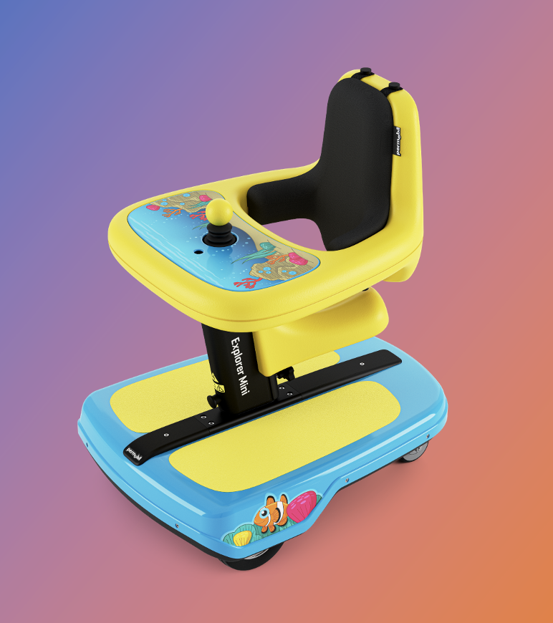
Background
Who are we trying to assist?
Oregon Go Baby Go Mission
Provide disabled children with cost-effective pediatric equipment for mobility and socialization.
What is the project?
Pediatric wheelchair
12-36 months
Why are we building this?
Help researchers understand motion data
Help children gain confidence
Sensory-Motor and social skills
The Device
Permobil Explorer Mini – the wheelchair
We are working on the attached “adherence sensor”
Notes:
Anna

Slide 7
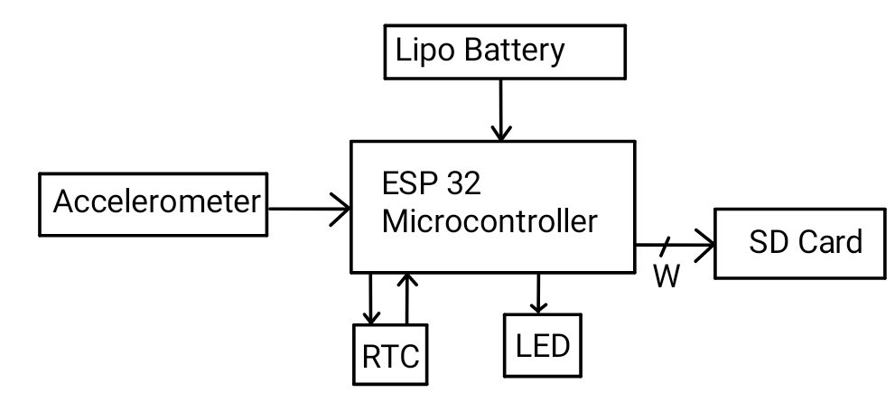
Block Diagram
Notes:
Kaylee

Slide 8
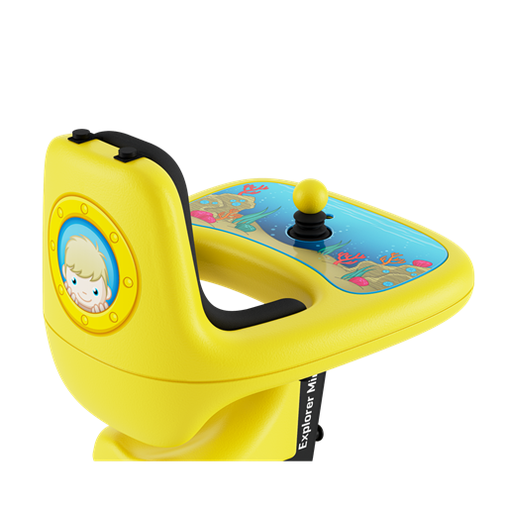
Controls
Cart
On/off
Joystick
Device
On/Off Button
Notes:
Margo

Slide 9
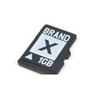
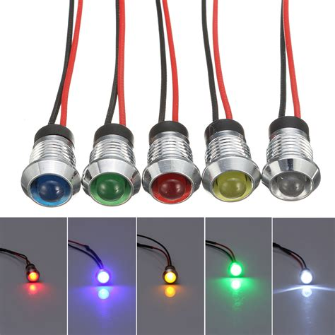
User Interface
Battery life indicator
LED
Audio
Data Transfer
Currently SD Card
Notes:
Anna

Slide 10
Design Challenges
Ease of Use
Low power mode
Data processing
Cost Efficiency
Notes:
Kaylee

Slide 11
Important Decisions
Usability for researchers
Transferring data
Data usability
Usability for families
Battery life indicator
Transferring data
Notes:
Margo

Slide 12
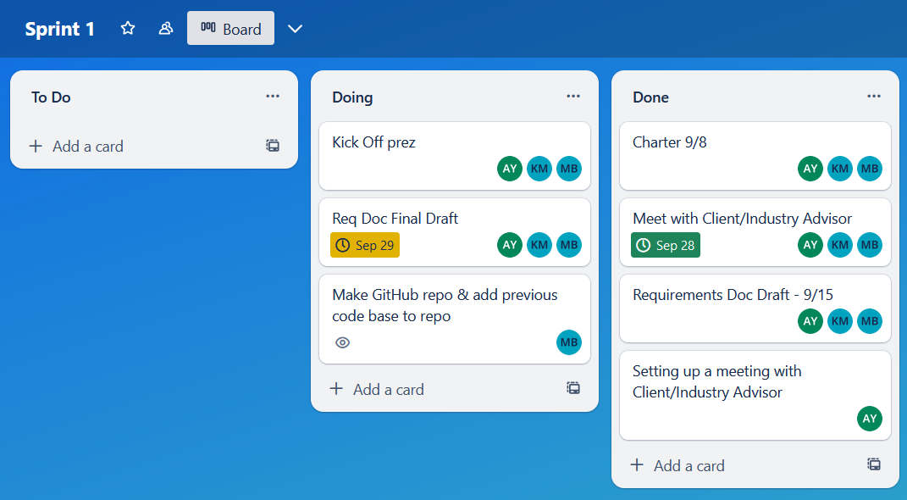
Sprint 1 Overview
Notes:
Anna

Slide 13
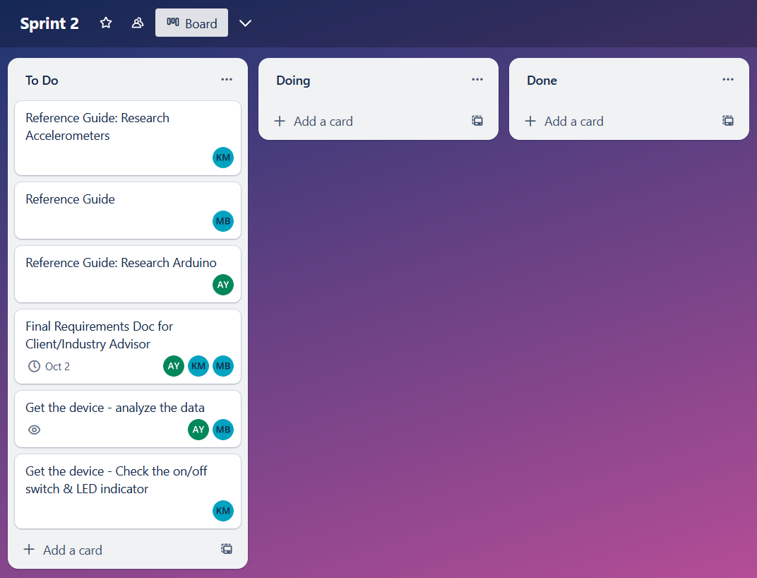
Sprint 2 Overview
Notes:
Kaylee

Slide 14
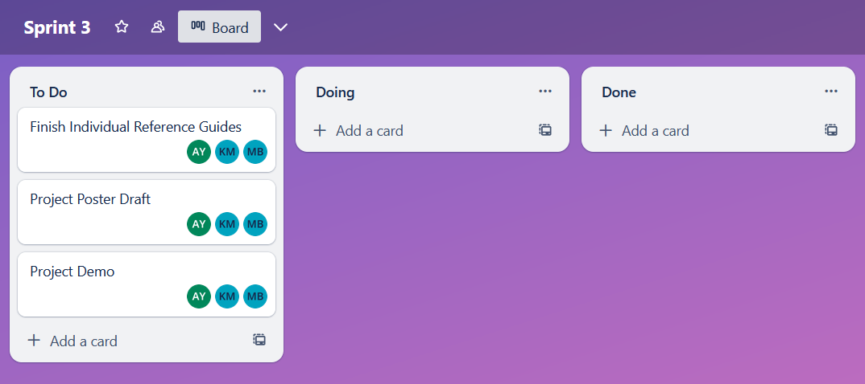
Sprint 3 Overview
Notes:
Margo

Slide 15
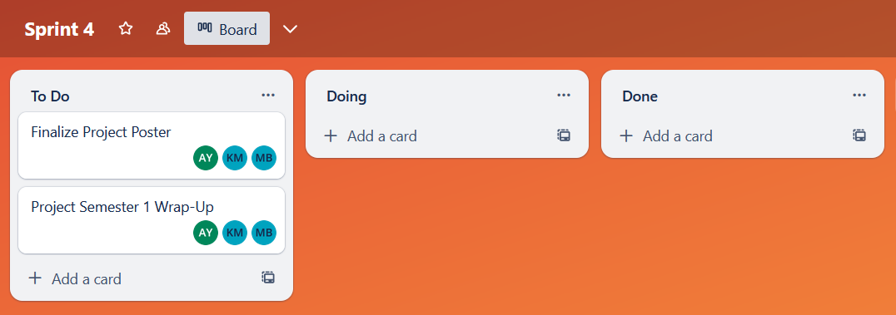
Sprint 4 Overview
Notes:
Anna

Slide 16
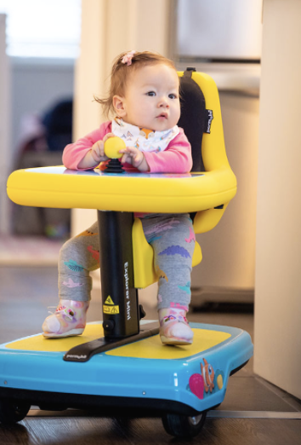
Screen Shot
Notes:
Kaylee

Slide 17
Conclusion
Improve a device that will help disabled children’s social and physical development
Help foster independence and curiosity in young children
Provide more opportunities for people with disabilities
Improve the data analytics process for parents and pediatricians
Notes:
Margo

Slide 18
Questions?

